Slide 1


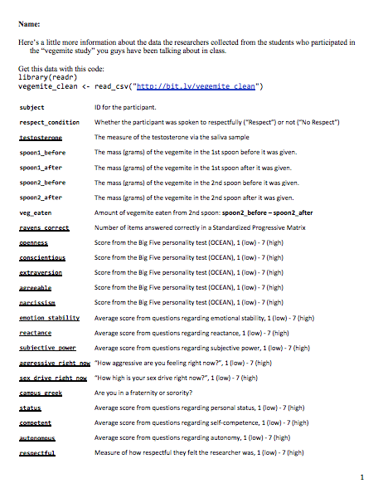

Getting started…
Rows A through J only; sit with a group of 3-5
#1. Take a look at the worksheet for the other data that the researchers collected. Why do some people eat more vegemite than others?

Slide 2
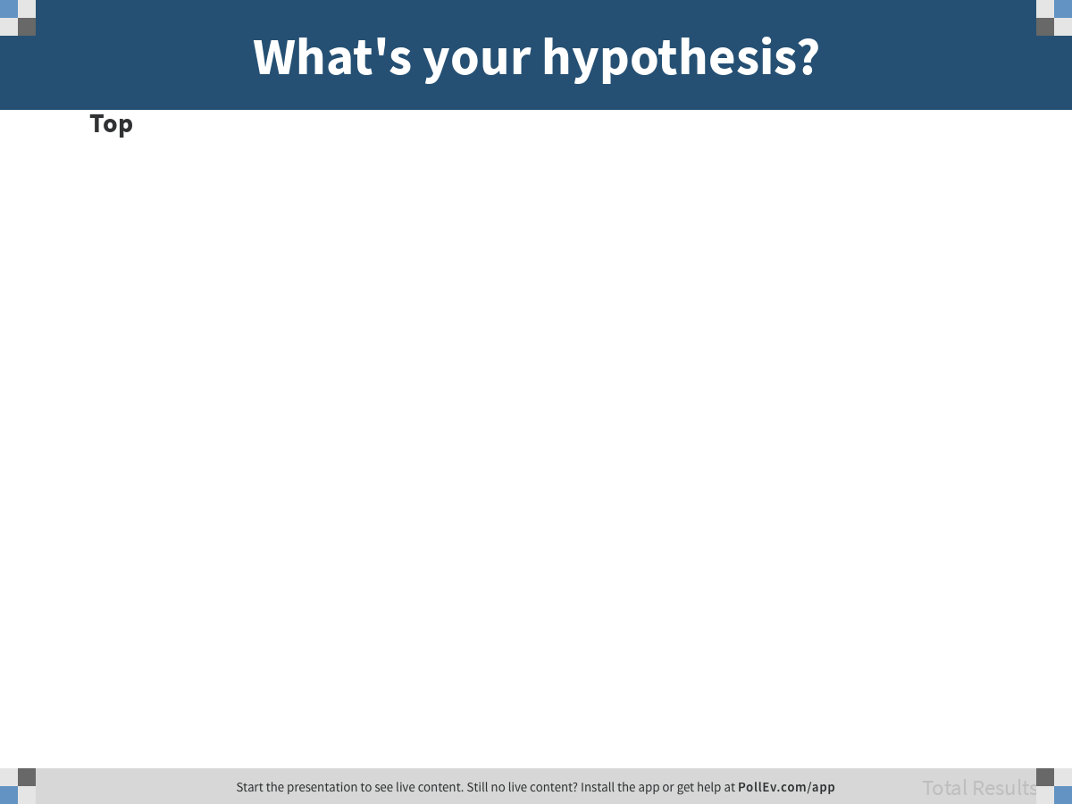
Notes:
What's your hypothesis?
https://www.polleverywhere.com/discourses/OoreVWLPQMflUfxgM79NR

Slide 3
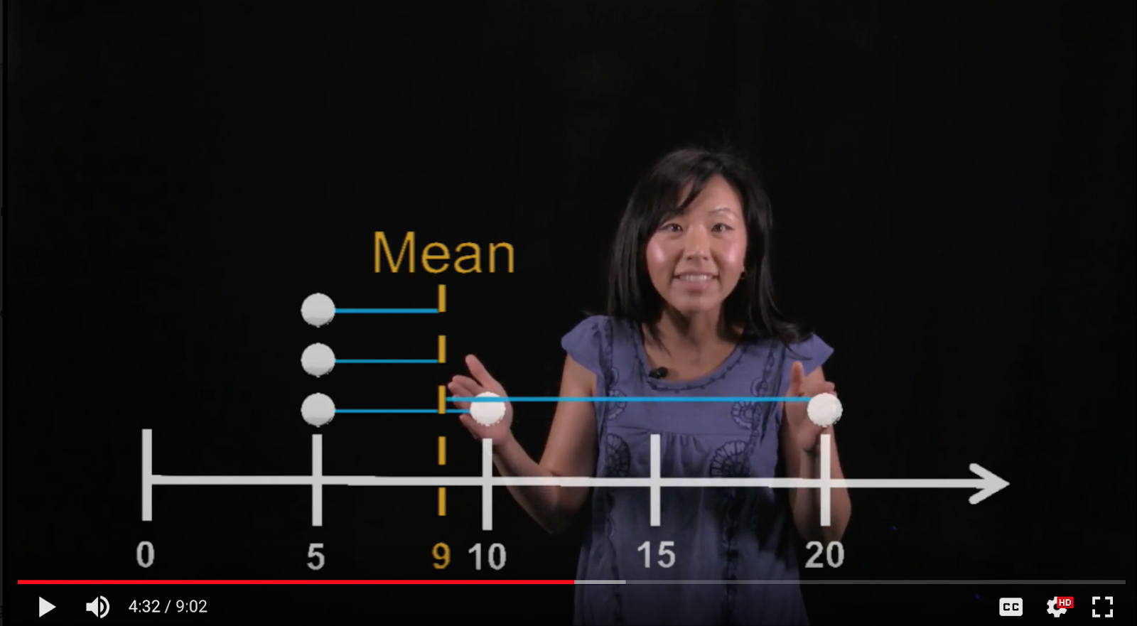
Who am I?

Slide 4
Adding an Explanatory Variable to the Model (Ch. 7 Continued)
Psych 100A Spring 2019
Prof. Jim Son

Slide 5
Today
Continue discussion of the two-group model
Partitioning scores
Linking to sums of squares
Connecting two-group model to regression model
Or, we can just answer your questions.

Slide 6
Back to the 2-group model for a while…

Slide 7
vegemite_clean
If you want to follow along, instructions to get this data set are on the worksheet.

Slide 8
Explore Variation: Make a scatterplot to see whether respect_condition explains variation in veg_eaten
veg_eaten = respect + error

Slide 9
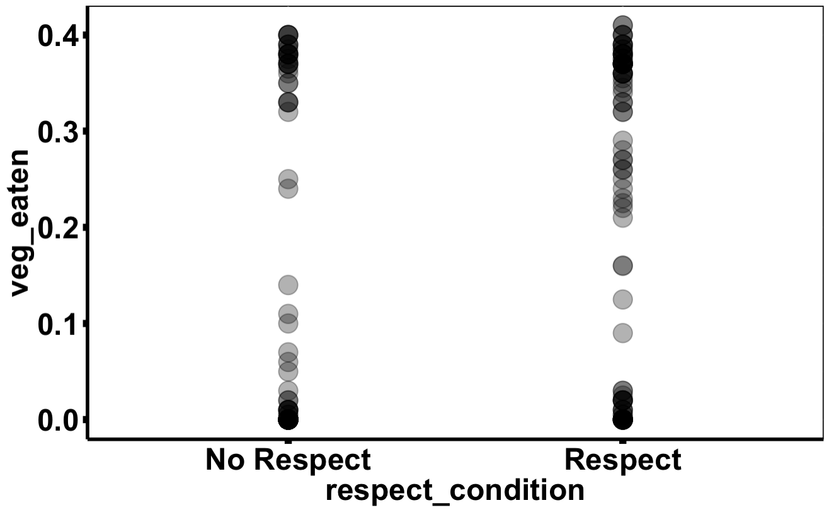
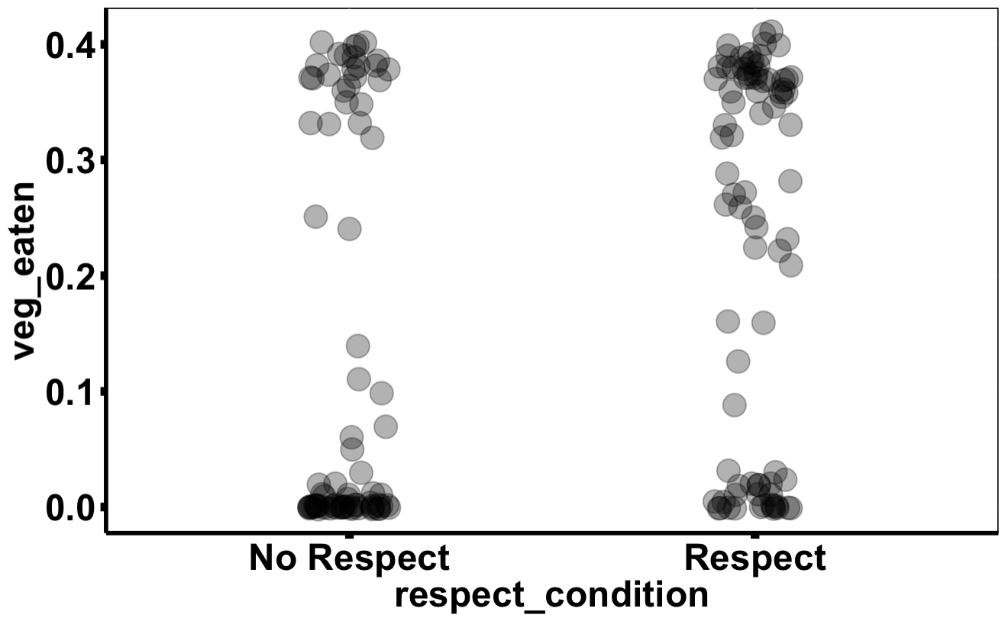
Why jitter plots come in handy…
veg_eaten = respect + error

Slide 10
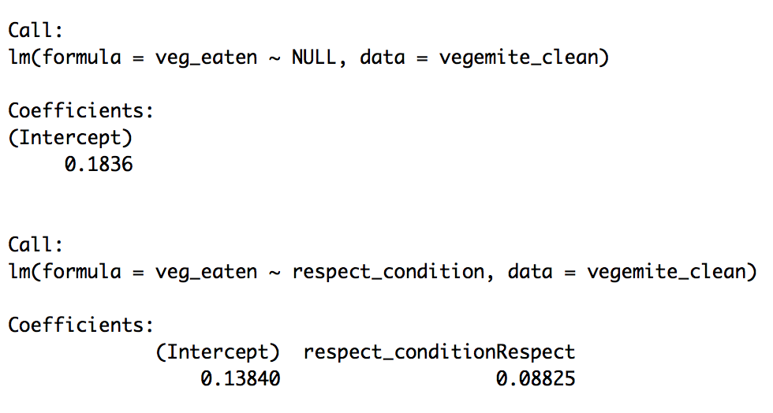
Model Variation #2. Let’s draw the models onto the jitter plot.
veg_eaten = mean + error
veg_eaten = respect + error

Slide 11
Model Variation: Let’s draw the models onto the jitter plot in R…. Using the predictions!

Slide 12
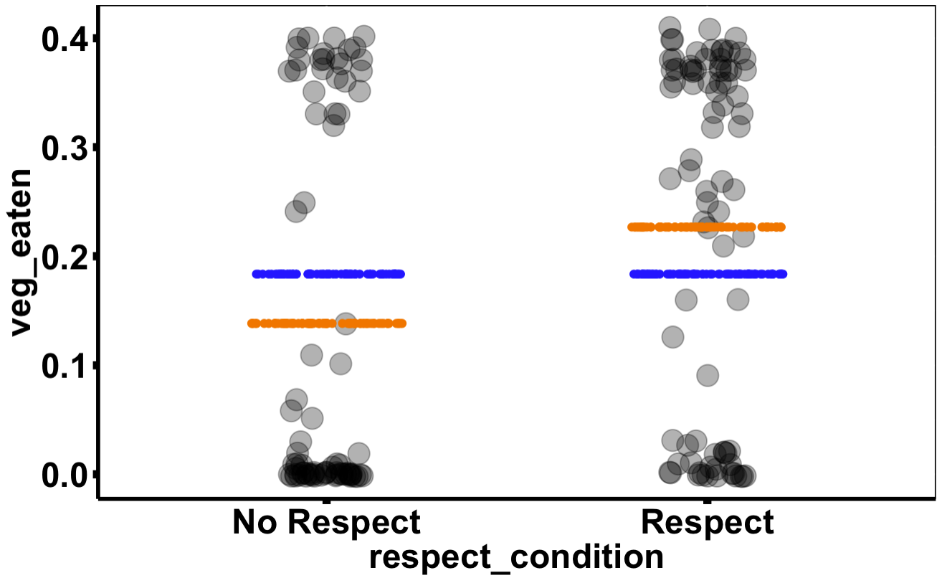
Model Variation: empty model’s predictions vs. respect model’s predictions

Slide 13
#3. Just by looking, is there left over variation from the respect model?

Slide 14
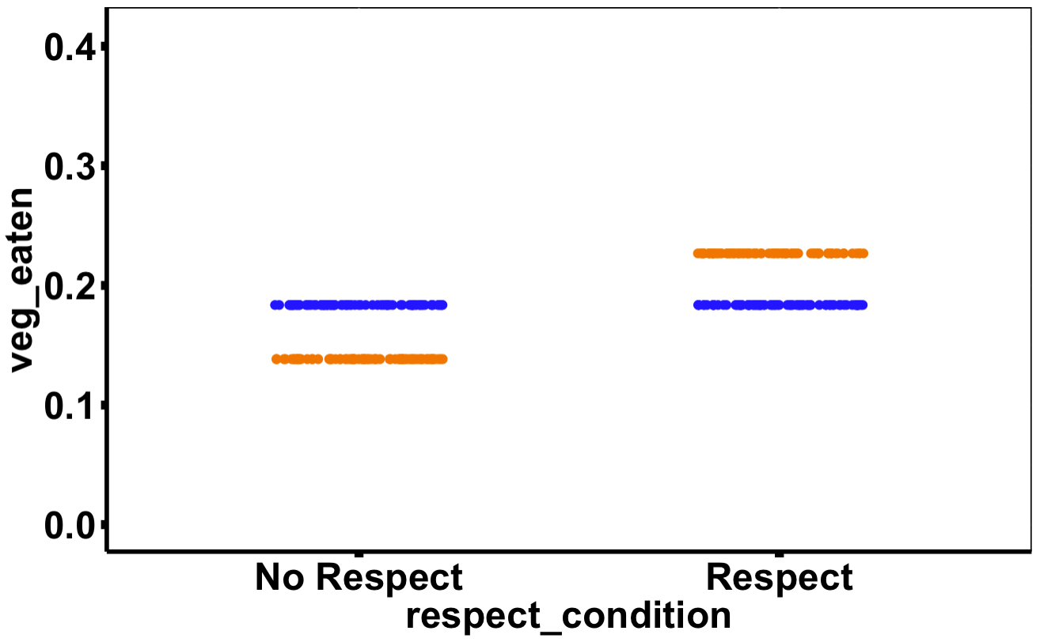
#4. What would the data look like if the respect model explained 100% of variation?

Slide 15
#4. What would the data look like if the respect model explained 100% of variation?

Slide 16
Now let’s draw the residuals!

Slide 17
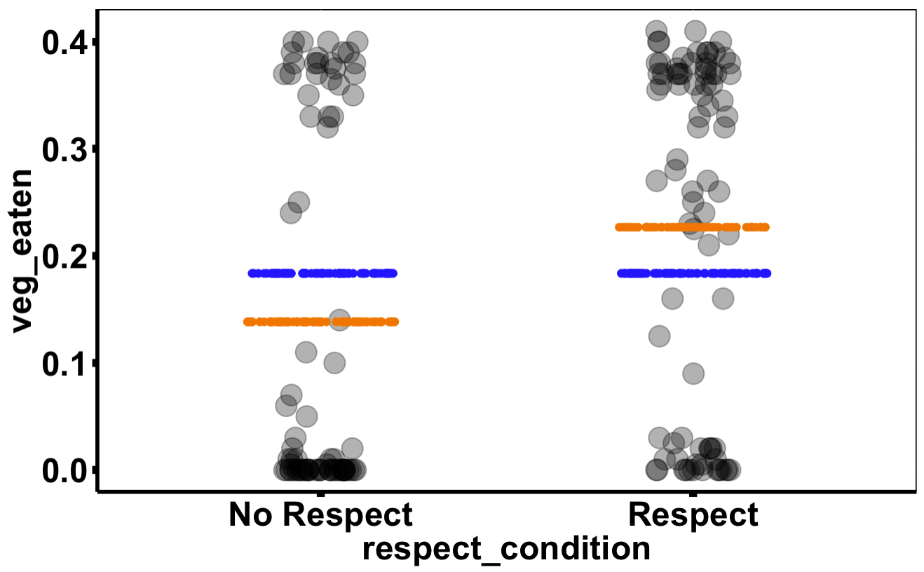
#5. empty model’s residuals vs. respect model’s residuals

Slide 18
#5. empty model’s residuals vs. respect model’s residuals

Slide 19
#5. empty model’s residuals vs. respect model’s residuals

Slide 20
#5. empty model’s residuals vs. respect model’s residuals

Slide 21
#5. empty model’s residuals vs. respect model’s residuals

Slide 22
#5. For this one person, how much error has been reduced by using the respect model? Draw it!

Slide 23
#5. For this one person, how much error has been reduced by using the respect model? Draw it!

Slide 24
#6. Residual from empty model always bigger than residual from complex model?

Slide 25
#6. Draw a counterexample.

Slide 26
#6. Residual from empty model always bigger than residual from complex model? NO

Slide 27
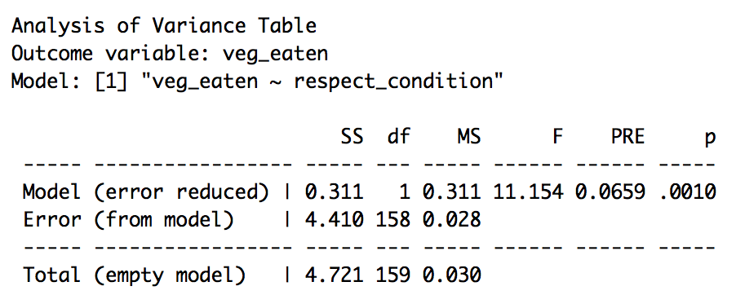
#7. WAIT! Isn’t the error from the empty model always bigger than error from the complex model?

Slide 28

AGGREGATED

Slide 29
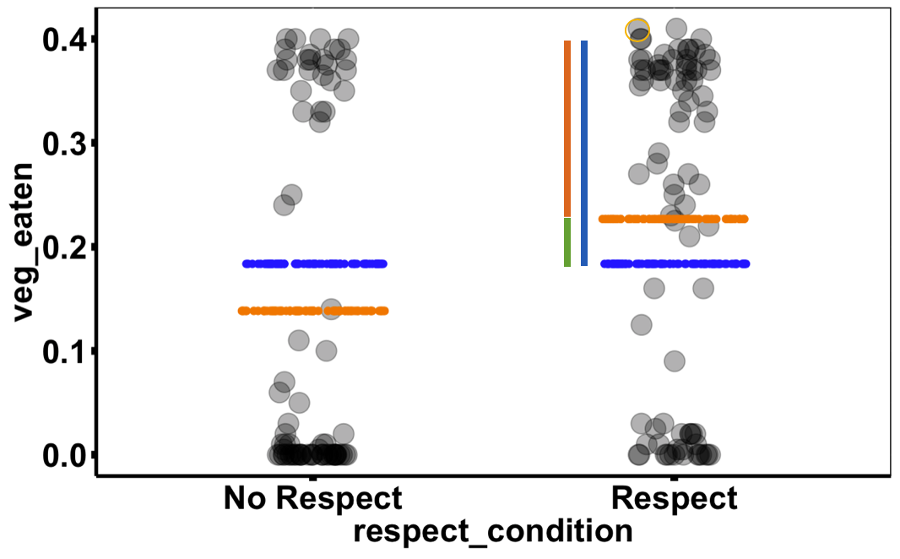
Error at Two Levels
Individual data points: residuals
Aggregated (the whole distribution): SS
SS Model
(explained)
SS Error (unexplained)
SS Total

Slide 30
Error at Two Levels
Individual data points: residuals
Aggregated (the whole distribution): SS
SS Model
(explained)
SS Error (unexplained)
SS Total

Slide 31
Error at Two Levels
SS Model
(explained)
SS Error (unexplained)
SS Total

Slide 32
#8. Draw a few squared residuals that go with each SS.

Slide 33
#8. SS Total

Slide 34
#8. SS Error

Slide 35
#8. SS Model

Slide 36
Run supernova() on both the empty.model and the respect.model.

Slide 37

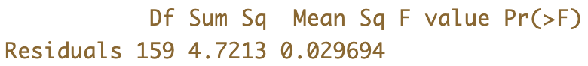
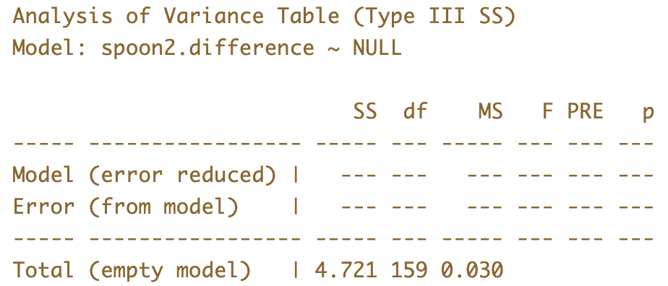
Sum of Squares: Empty Model
anova()
superanova()
The rest of the course will involve getting gaining an intimate working understanding of this table.

Slide 38
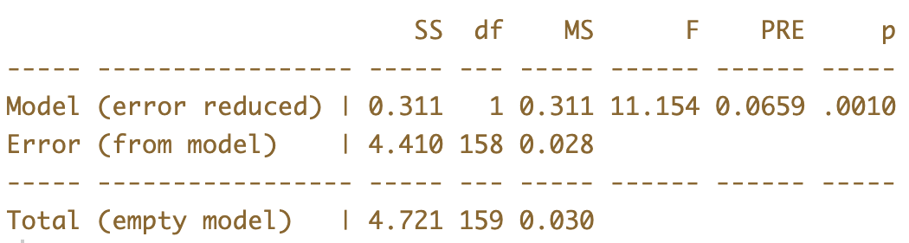
Sum of Squares: Two-Group Model

Slide 39
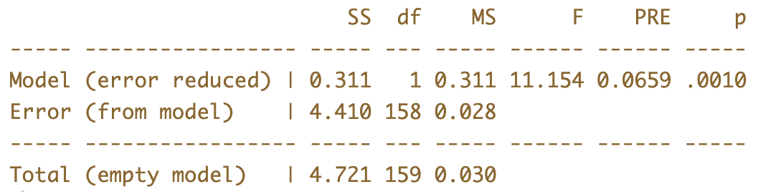
Is .311 a lot of error reduced? How should we judge that amount?
SS Model
SS Error
Group
Model
SS Total
Empty
Model

Slide 40
PRE: Converting Squared Error Units into Proportion
SS Model
SS Error
Group
Model
SS Total
Empty
Model
How would you calculate PRE from these three Sums of Squares?

Slide 41
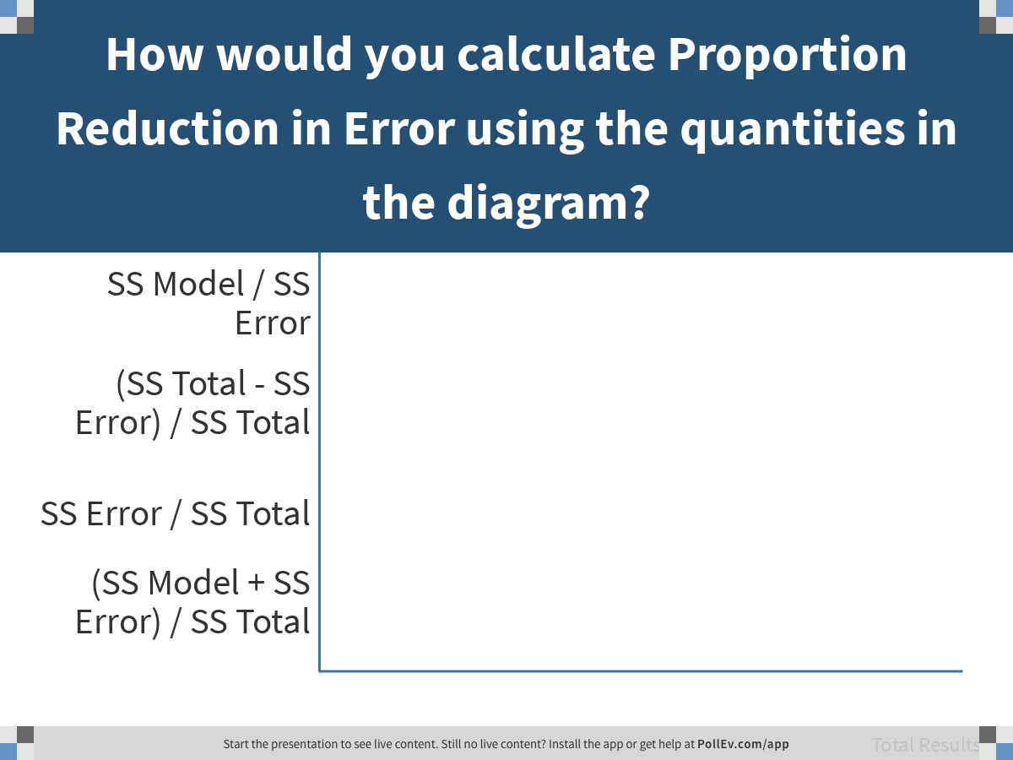
Notes:
How would you calculate Proportion Reduction in Error using the quantities in the diagram?
https://www.polleverywhere.com/multiple_choice_polls/ef4t97zH03lNVlhBm4Khx

Slide 42
SS Model
SS Error
Group
Model
SS Total
Empty
Model
SS Model / SS Total = .07

